Slide 1

Image Steganography
Using MATLAB
Ilham Hamid 21PWCSE2017 Aimal Khan 21PWCSE1996 Alina Khewal 21PWCSE2060

Slide 2

CONTENTS
Problem Statement
Steganography
Concept of LSB Based Data Embedding
MATLAB
Proposed Methodology
Results
Conclusion
References

Slide 3

PROBLEM STATEMENT
In today's digital era, secure communication and the protection of sensitive information has become crucial. Traditional encryption techniques alone may not provide sufficient security against potential threats.
Hence, there is a need for an advanced approach that combines encryption with steganography, enabling the hidden transmission of secret information within innocuous digital media such as images, videos, or audio files. This project aims to address this requirement by implementing LSB-based steganography using MATLAB, providing an effective means to safeguard sensitive data during transmission, enhancing the confidentiality and integrity of communication channels.

Slide 4
STEGANOGRAPHY
Steganography is the method of hiding secret data inside any form of digital media. The main idea behind steganography is to hide the existence of data in any medium like audio, video, image, etc.
When we talk about image steganography, the idea is quite simple. Images are made up of pixels which usually refer to the color of that particular pixel. In a grayscale (black and white) image, these pixel values range from 0-255, 0 being black and 255 being white.

Slide 5
LSB BASED DATA EMBEDDING
LSB stands for Least Significant Bit. The idea behind LSB embedding is that if we change the last bit value of a pixel, there won’t be much visible change in the color. For example, 0 is black. Changing the value to 1 won’t make much of a difference since it is still black, just a lighter shade.

Slide 6
MATLAB
MATLAB, known as Matrix Laboratory, is a highly influential programming language and environment tailored for numerical computations, data analysis, and visualization. With its exceptional versatility and intuitive interface, MATLAB serves as an optimal platform for implementing a diverse range of image processing methodologies, steganography being one of them.
In this project, we leverage the capabilities of MATLAB to develop a program for LSB- based steganography. By harnessing MATLAB's extensive array of built-in functions and toolboxes, we can efficiently manipulate digital images and embed confidential information within them. The integration of MATLAB's advanced image processing features with the concept of steganography enables us to create a robust and effective solution for secure data transmission and protection.

Slide 7
PROPOSED METHODOLOGY
Convert the image to grayscale.
Resize the image if needed.
Convert the message to its binary format.
Initialize output image same as input image.
Traverse through each pixel of the image and do the following:
Convert the pixel value to binary.
Get the next bit of the message to be embedded.
Create a variable temp.
If the message bit and the LSB of the pixel are same, set temp = 0
If the message bit and the LSB of the pixel are different, set temp = 1
This setting of temp can be done by taking XOR of message bit and the LSB of the pixel.
Update the pixel of output image to input image pixel value + temp.
Keep updating the output image till all the bits in the message are embedded.
Finally, write the input as well as the output image to the local system.

Slide 8
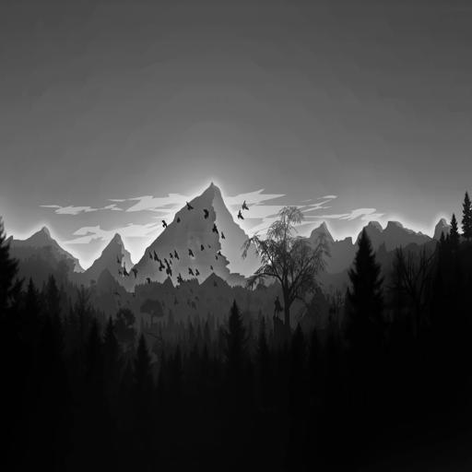

RESULTS
Fig. 1. Input Image
Fig. 2. Output Image with text ‘secret’ embedded

Slide 9
CONCLUSION
In conclusion, the implementation of LSB-based steganography using MATLAB provides a reliable method for hiding secret data within digital images, ensuring secure communication and confidentiality of information. This project offers a practical and effective solution for data concealment while leveraging the power of MATLAB's image processing capabilities.

Slide 10
REFERENCES
http://www.mathworks.com
https://www.geeksforgeeks.org
https://www.simplilearn.com/

